Slide 1
G2M Case Study
Virtual Internship
FNU Mrinal Shasta Rajput
14-Feb-2024

Slide 2
Background –G2M(cab industry) case study
XYZ is a private equity firm in US. Due to remarkable growth in the Cab Industry in last few years and multiple key players in the market, it is planning for an investment in Cab industry.
Objective : Provide actionable insights to help XYZ firm in identifying the right company for making investment.
The analysis has been divided into four parts:
Data Understanding
Forecasting profit and number of rides for each cab type
Finding the most profitable Cab company
Recommendations for investment

Slide 3
Data Exploration
14 Features
Timeframe of the data: 2016-01-31 to 2018-12-31
Total data points :359393
Assumptions:
Outliers are present in Price_Charged feature but due to
unavailability of trip duration details ,we are not treating this as outlier.
Profit of rides are calculated keeping other factors constant and only
Price_Charged and Cost_of_Trip features used to calculate profit.
Users feature of city dataset is treated as number of cab users in the city.
we have assumed that this can be other cab users as well(including Yellow and
Pink cab)
Cab_Data.csv
Customer_ID.csv
Transaction_ID.csv
City.csv
Final cab data

Slide 4
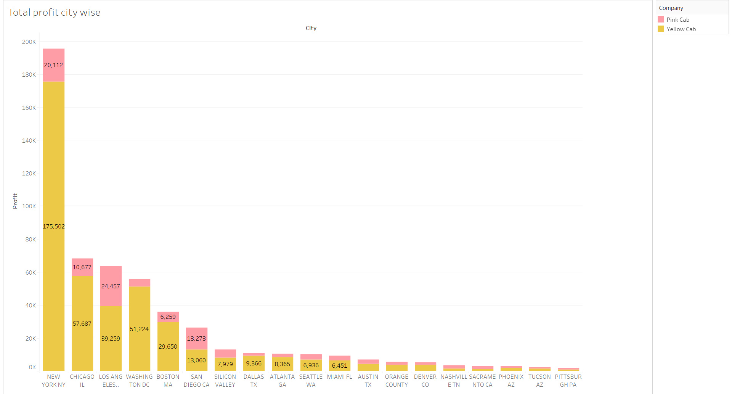
Profit Analysis

Slide 5
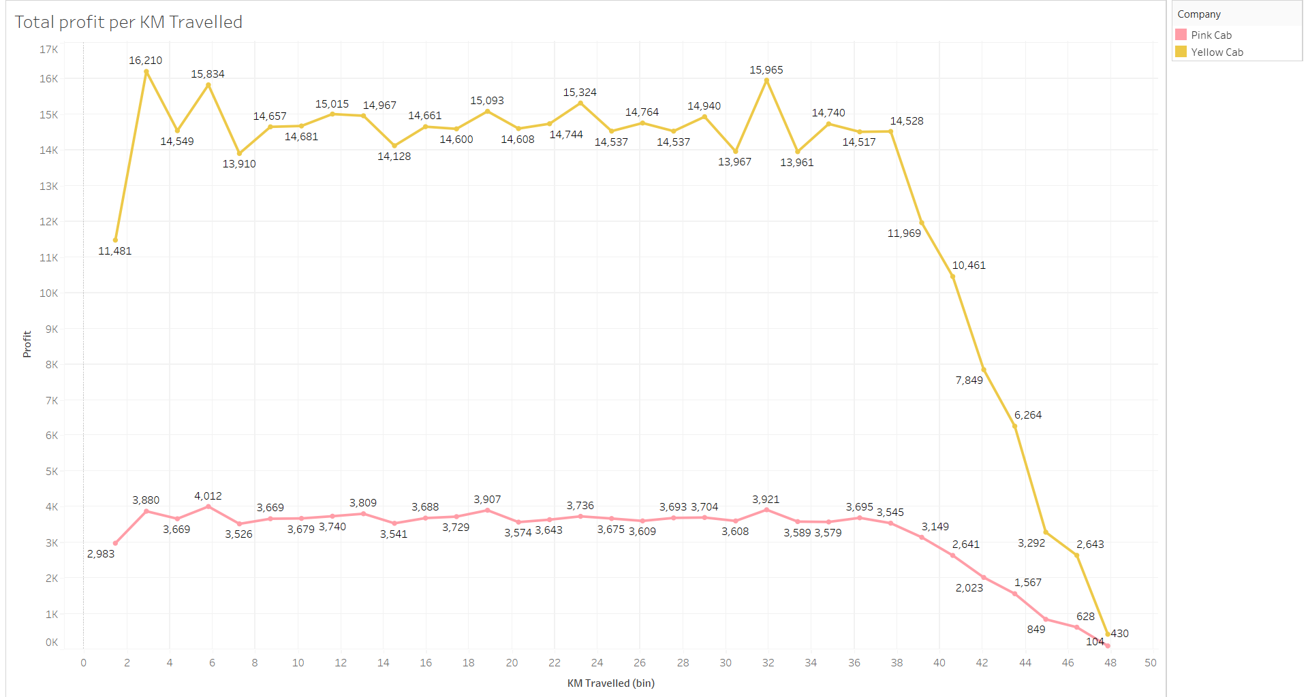

Slide 6
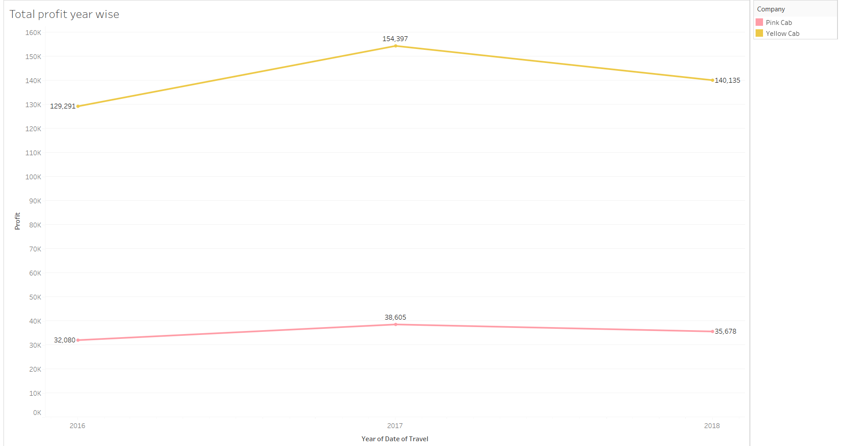
Yearly Profit Analysis

Slide 7
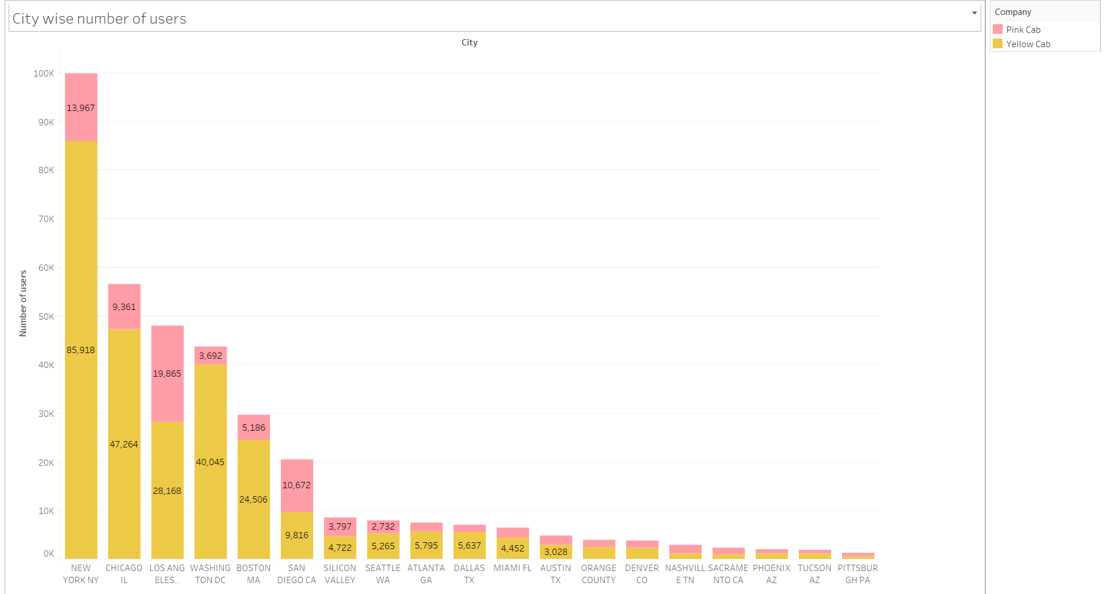
City Wise Cab Users Covered By Company

Slide 8
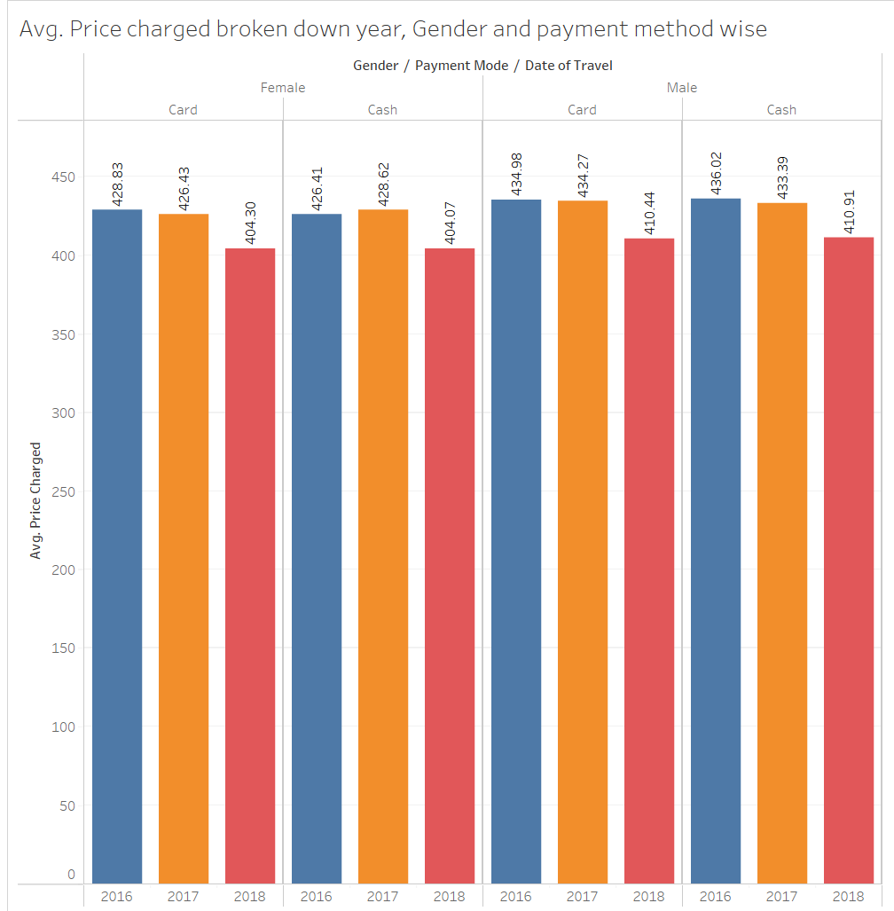
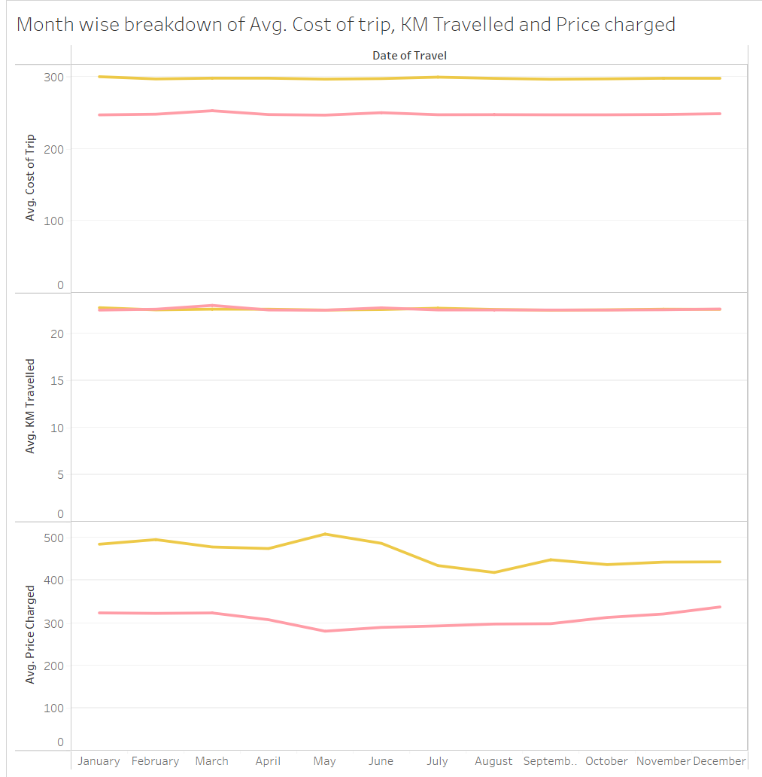
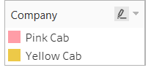

Slide 9
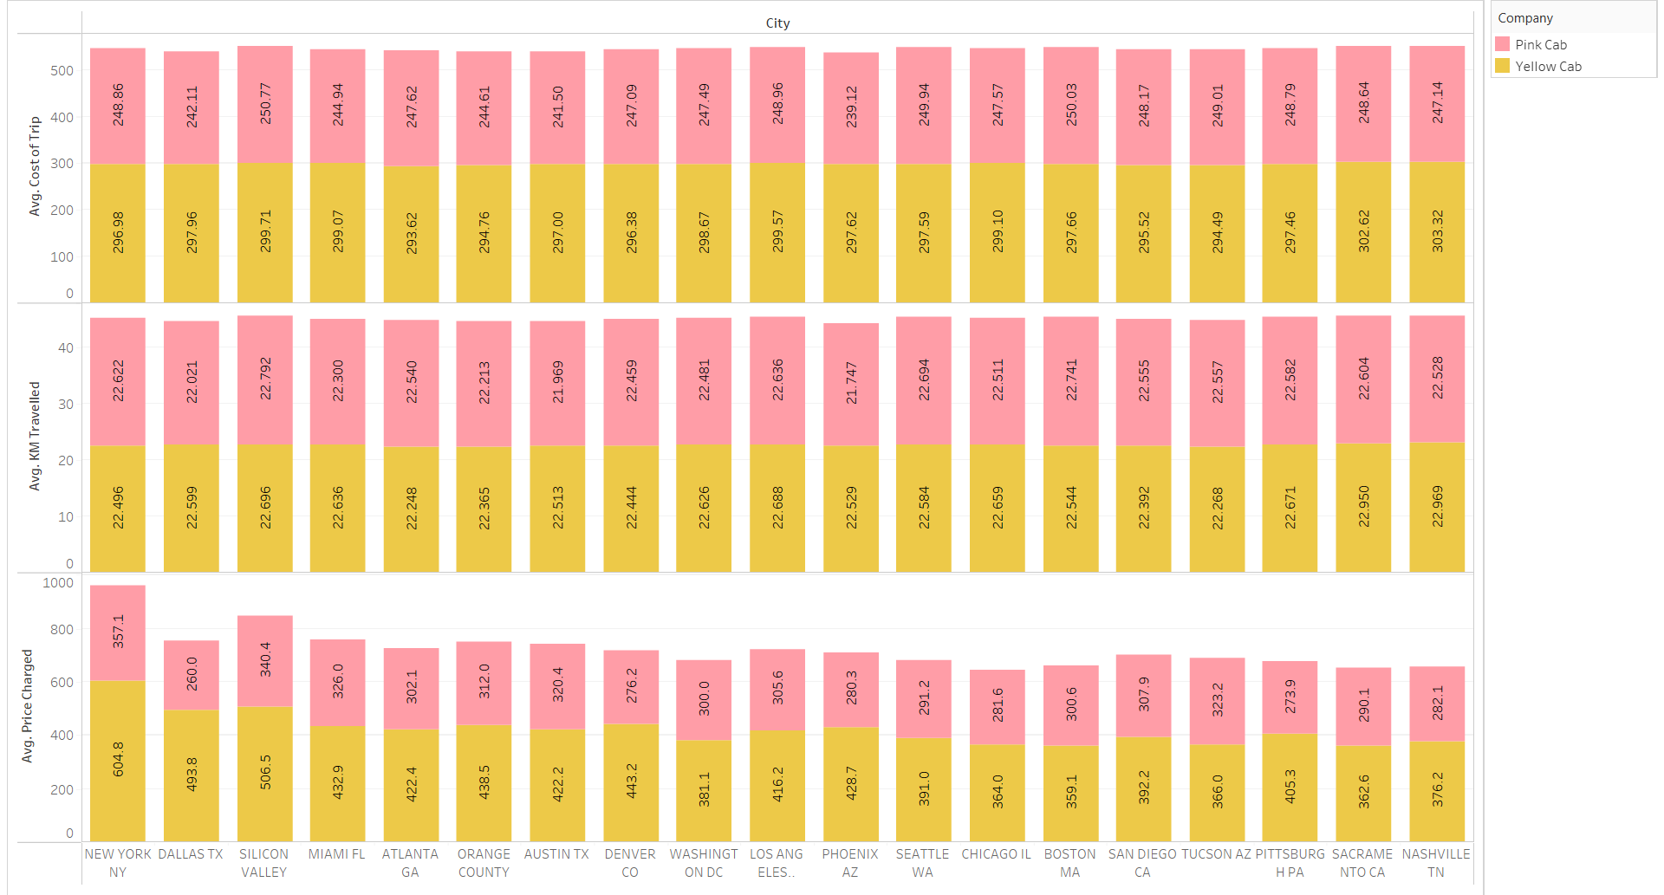

Slide 10
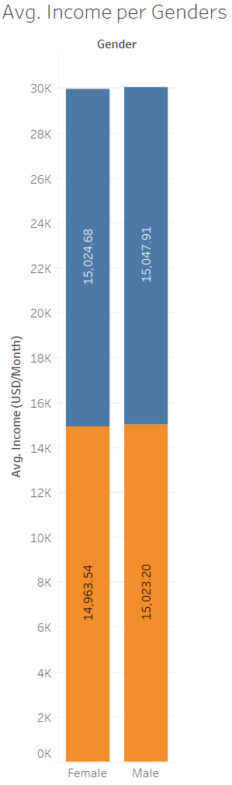

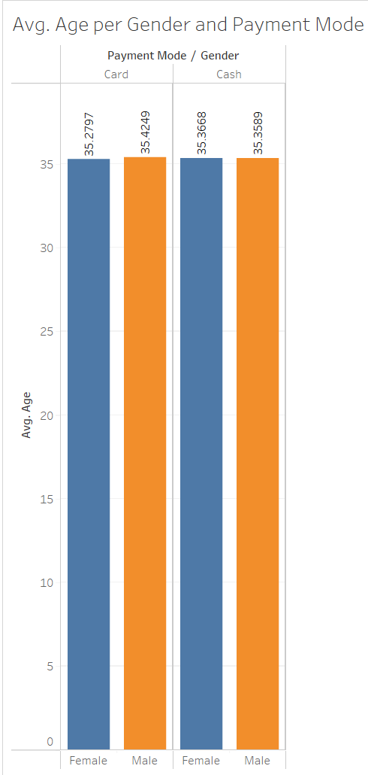
Customer information

Slide 11
Recommendations
After evaluating both cab companies across several criteria, we have determined that Yellow cab surpasses Pink cab in the following aspects:
Market Reach: Yellow cab exhibits a broader market reach, operating in 18 cities compared to Pink cab's presence in only 1 cities. Furthermore, Yellow cab demonstrates better coverage among various segments of cab users compared to Pink cab.
Customer Retention: Our analysis of customer retention, categorized by at least 5 and 10 drives with the same cab company, reveals that Yellow cab significantly outperforms Pink cab in both segments.
Average Profitability per Kilometer: The average profit per kilometer for Yellow cab is ,ore than three times higher than that of Pink cab, indicating a stronger profitability model for Yellow cab.
Income-Based Market Penetration: Although both cab companies are popular among high and medium-income groups, Yellow cab excels in catering to a broader spectrum of customers, including low, medium, and high-income segments, outpacing Pink cab in all three income classes.
On the basis of above point , we will recommend Yellow cab for investment.

Slide 12
Thank You

